Slide 1


High-Level Design
A Test-Driven Approach

Slide 2


Summary
The Baby That Got Thrown Out With The Bathwater
Roles, Responsibilities & Collaborations
Simple HLD Modeling Tools
Specification By Example
From Features to High-Level Designs

Slide 3


The Baby That Got Thrown Out With The Bathwater
How Jumping Straight Into Code Created an Epidemic of God Modules

Slide 4
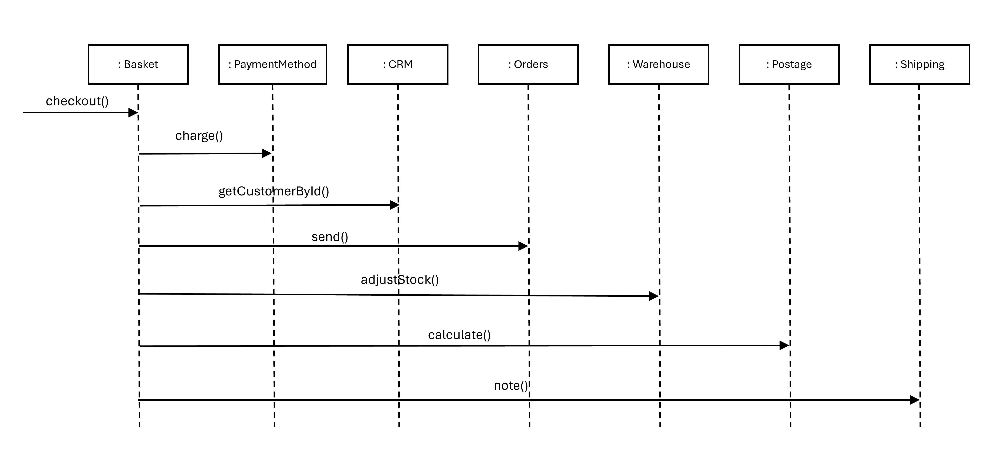

Slide 5
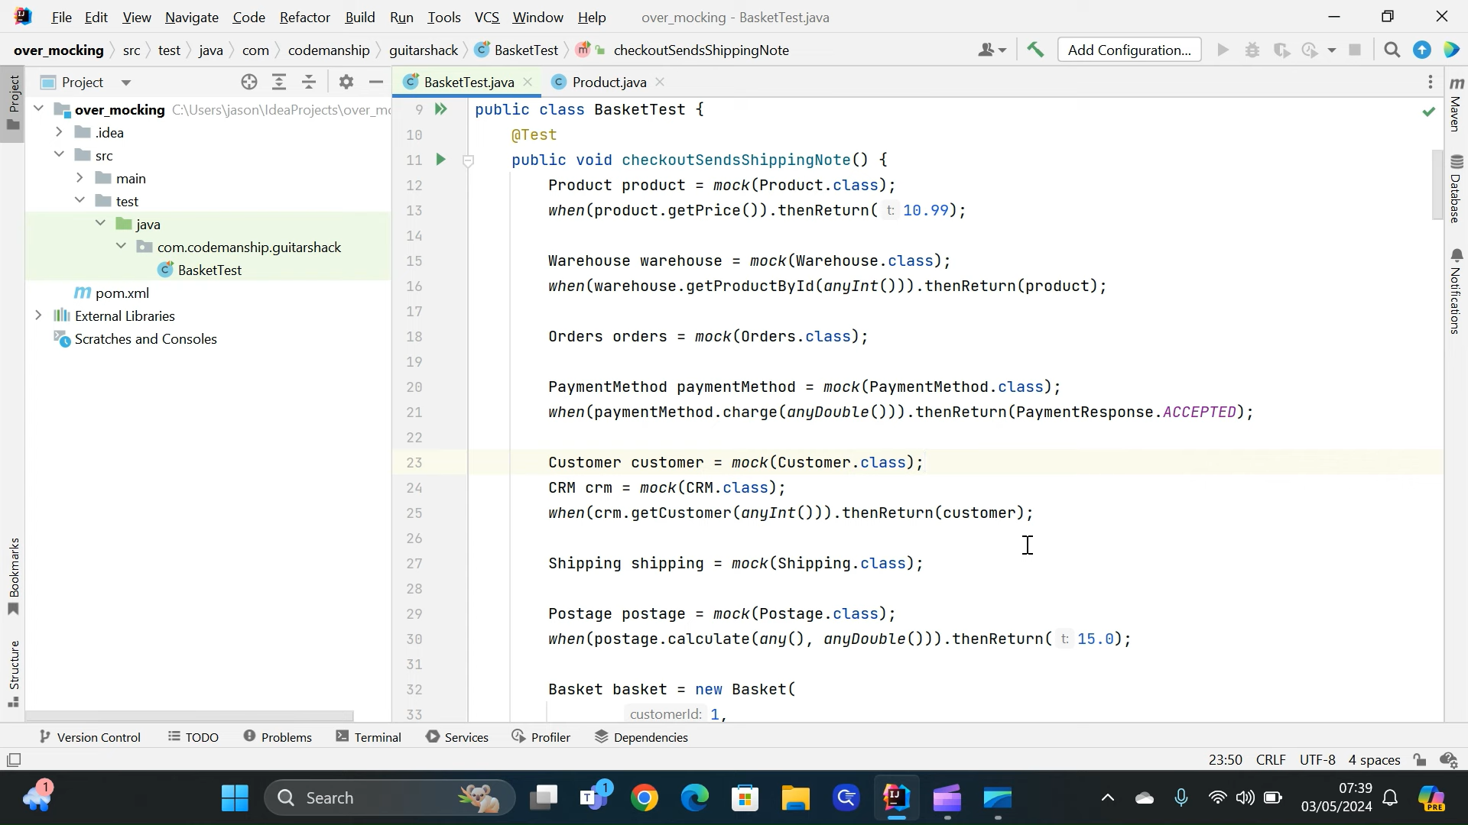
© Codemanship Ltd 2024

Slide 6
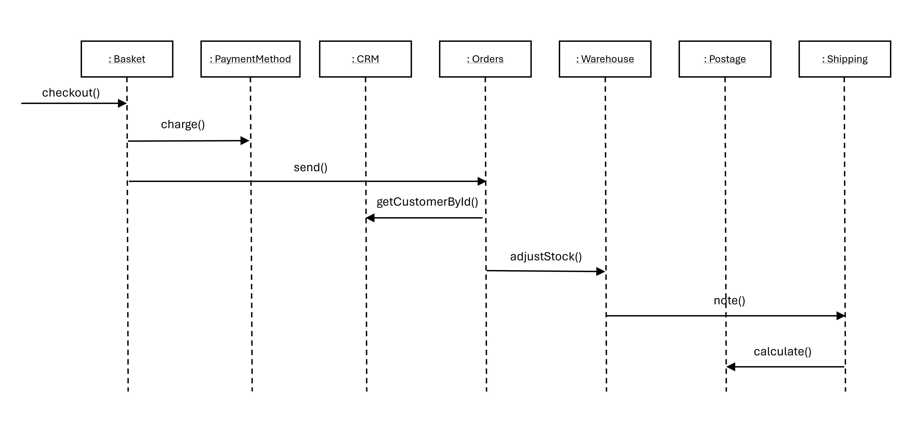

Slide 7
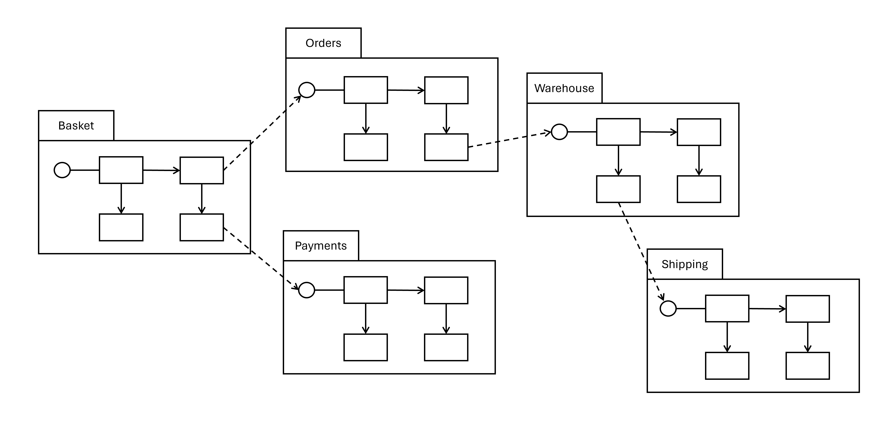

Slide 8

Roles, Responsibilities & Collaborations
The Essence of High-Level Design

Slide 9


Slide 10
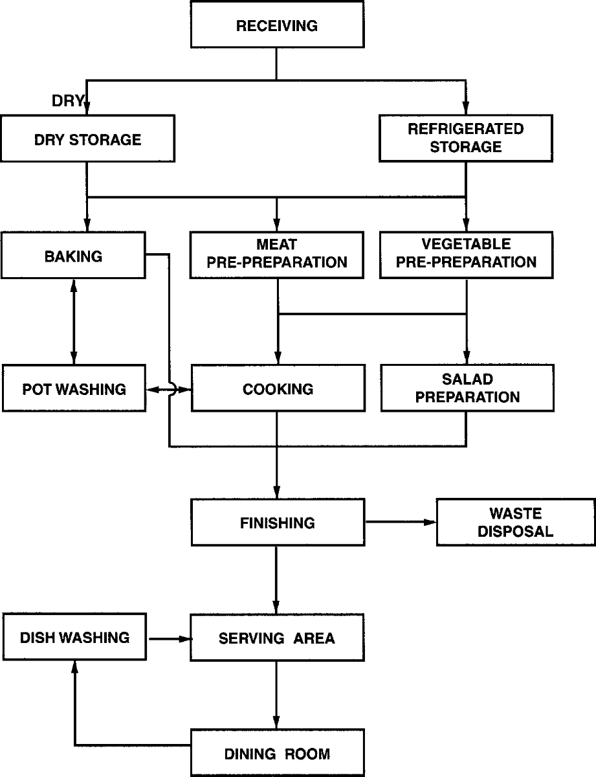

Slide 12

Simple High-Level Design Tools
Visualising Roles, Responsibilities & Collaborations

Slide 14
Basket
1
PaymentMethod
Postage
customerId
items
type: Payment Type
charge(amount)
calculate(region, orderTotal)
checkout()
1
1
1
1
Orders
Warehouse
Shipping
stock
send(order)
adjustStock(order)
note(order)
1
CRM
getCustomerById(id)

Slide 15

Basket
knows
Orders
* Customer id
Payment Method
* items
does
* checkout

Slide 16

Specification By Example
Pinning Down Requirements With Test Cases

Slide 17
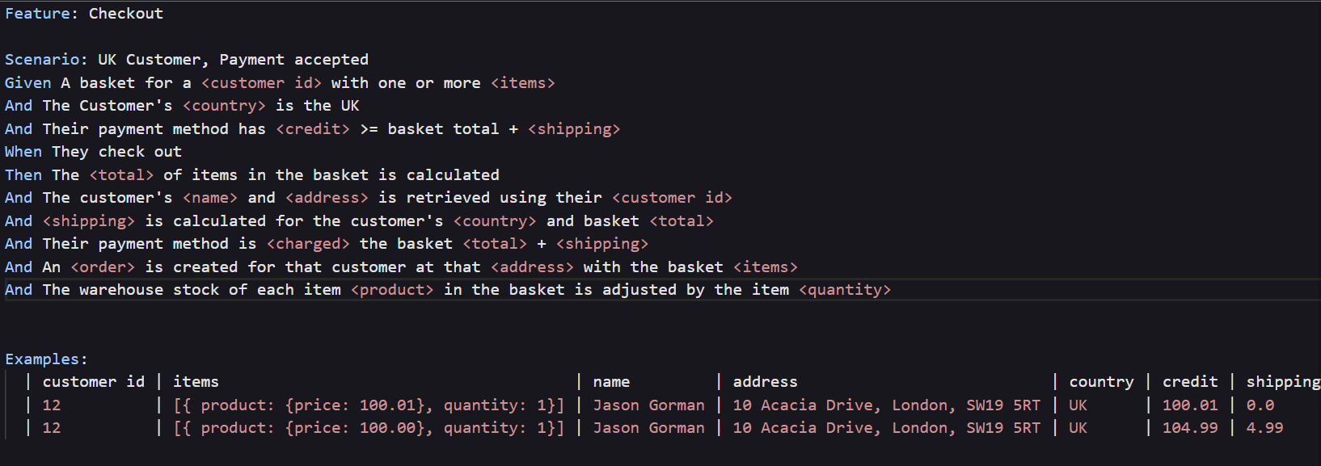

Slide 18

From Features To High-Level Designs
Mapping Roles, Responsibilities & Collaborations One Slice At A Time

Slide 19
does
does
does
* Calculate total of items
* Retrieve customer’s name & address
* Calculate shipping
does
does
does
* Charge basket total + shipping
* Create order
* Adjust product stock

Slide 20
knows
knows
knows
* Items
* customer id
* customers
* regions
does
does
does
* Calculate total of items
* checkout
* Retrieve customer’s name & address
* Calculate shipping
knows
knows
* credit
* stock
does
does
does
* Charge basket total + shipping
* Create order
* Adjust product stock

Slide 21
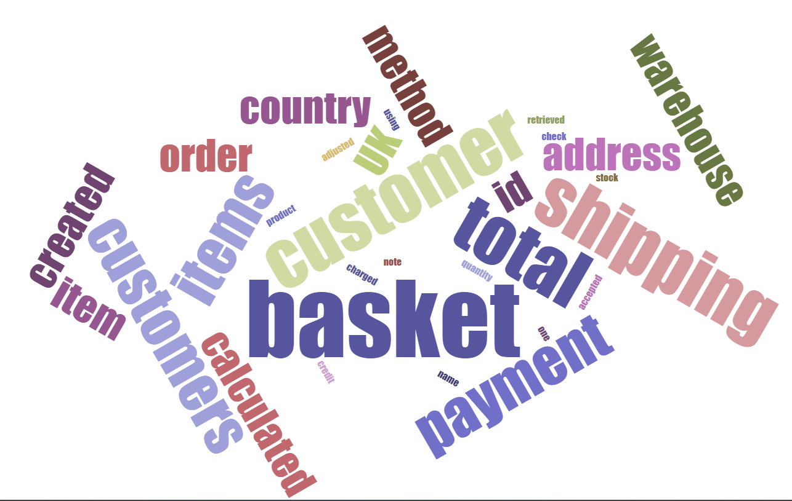

Slide 22
Basket
Customers
Shipping
knows
knows
knows
* Items
* customer id
* customers
* regions
does
does
does
* Calculate total of items
* checkout
* Retrieve customer’s name & address
* Calculate shipping
Payment Method
Orders
Warehouse
knows
knows
* credit
* stock
does
does
does
* Charge basket total + shipping
* Create order
* Adjust product stock

Slide 23

Basket
Customers
Shipping
knows
Customers
Shipping
Payment Method
Orders
Warehouse
knows
knows
* Items
* customer id
* customers
* regions
does
does
does
* Calculate total of items
* checkout
* Retrieve customer’s name & address
* Calculate shipping
Payment Method
Orders
Warehouse
knows
knows
* credit
* stock
does
does
does
* Charge basket total + shipping
* Create order
* Adjust product stock

Slide 24
: Basket
: Customers
: Shipping
: Payment Method
: Orders
: Warehouse
checkout
retrieve customer
calculate shipping
charge
create order
adjust stock

Slide 25

Basket
Customers
Shipping
knows
Customers
Orders
knows
knows
* Items
* customer id
* customers
* regions
does
does
does
* Calculate total of items
* checkout
* Retrieve customer’s name & address
* Calculate shipping
Payment Method
Orders
Warehouse
knows
Shipping
Warehouse
Payment Method
knows
* credit
* stock
does
does
does
* Charge basket total + shipping
* Create order
* Adjust product stock

Slide 26
: Basket
: Customers
: Orders
: Payment Method
: Shipping
: Warehouse
checkout
retrieve customer
create order
charge
calculate shipping
adjust stock

Slide 27

Business Requirements
Guitar Shack

Slide 28
Guitar Shack Sales System
You are tasked with developing a sales and stock control system for a guitar shop
The initial system will have functionality in three areas:
Orders
Warehouse
Sales History
Shipping

Slide 29
Order Features
Add item – add an item to an order. An order item has a product and a quantity. There must be sufficient stock of that product to fulfil the order
Total including shipping – calculate the total amount payable for the order, including shipping to the address
Confirm – when an order is confirmed, the stock levels of every product in the items are adjusted by the item quantity, and then the order is added to the sales history.

Slide 30
Warehouse Features
Check stock – for a specified product, get the current stock level
Adjust stock – deduct a quantity from a product’s stock level
Receive stock – add new stock to a product, and if the product is new, add it to the catalogue first
Restock Alerts – when stock’s adjusted, if that product has reached its restock threshold, where we’ll need to order more to avoid running out before more stock arrives from the manufacturer, an alert is sent to the warehouse manager. Use the product’s sales history and its restock lead time to calculate what the restock level should be.

Slide 31
Sales History Features
List orders of a specific product (optionally within a date range)
List orders shipped to an address

Slide 32
Shipping
Shipping charges for orders are calculated as follows:
Region | Order total > £100 | Order total <= £100
UK | FREE | £4.99
EU | £4.99 | £7.99
OTHER | £7.99 | £12.99

Slide 33
Contact us
www.codemanship.com
Twitter: @codemanship

